Slide 1
AOZ Challenge StockHub
Daniel Maksimovic, Katerina Kuneva, Nils Grob
Zürich, 01.09.2025

Slide 2
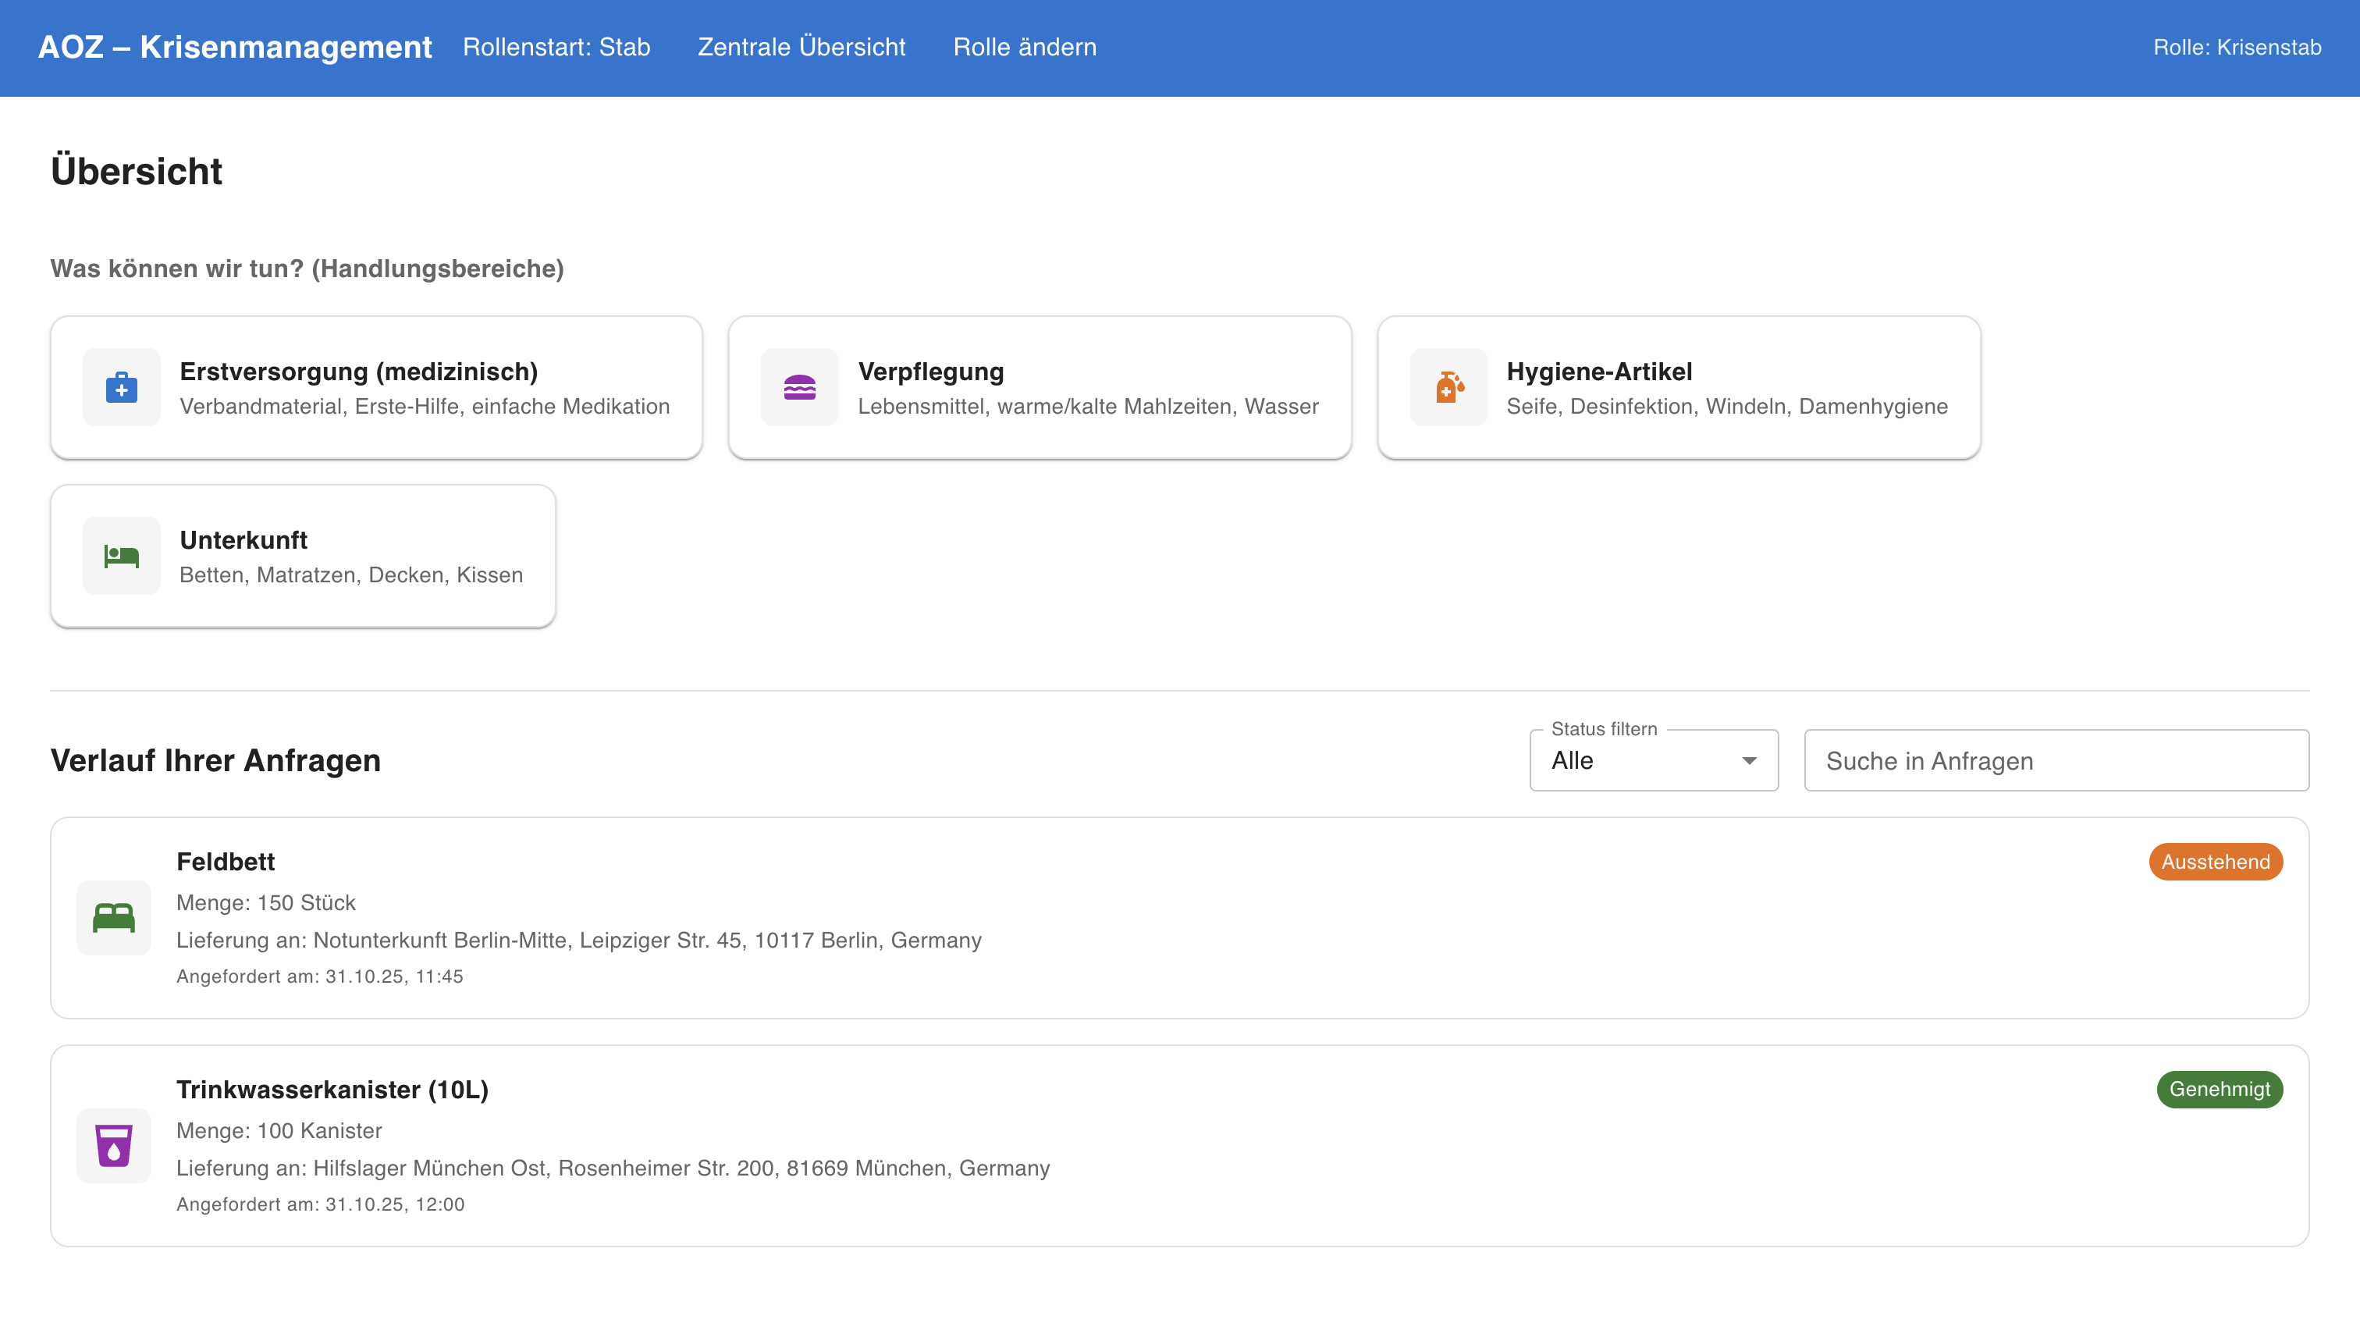
Intro
Insert Chapter title
StockHub: a shared, city-wide platform to plan, store, and deploy emergency supplies fast.

Slide 3
Current Challenges
Insert Chapter title
Fragmented Procurement: Parallel procurement and storage across city actors lead to duplication, higher costs, slow coordination, and last-minute panic buying.
Disconnected Logistics: Crisis teams and logistics management all need the same emergency goods but lack a shared overview, which causes coordination gaps.
Reactive, not prepared: During a refugee influx, arrivals can spike overnight. Needs are unpredictable, information is fragmented, and setup of temporary housing is delayed.

Slide 4



Current Challenges
Fragmented Procurement
Disconnected Logistics
Reactive, not prepared
Parallel procurement and storage across city actors lead to duplication, higher costs, slow coordination, and last-minute panic buying.
Crisis teams and logistics management all need the same emergency goods but lack a shared overview, which causes coordination gaps.
During a refugee influx, arrivals can spike overnight. Needs are unpredictable, information is fragmented, and setup of temporary housing is delayed.

Slide 5
Our Solution
Insert Chapter title
StockHub: One shared platform to plan, source, store, and deploy emergency supplies across city actors, with role-based access and readiness tracking
Three Core Features:
Stab Dashboard: Overview and action center for the crisis management staff.
Autorisation Dashboard: Validation and approval interface for stock requests.
Organisation Dashboard: Stock, logistics, and inspection management for local facilities.

Slide 6
Demo
Insert Chapter title

Slide 7
Impact & Outlook
Insert Chapter title
From Chaos to Organization:
Faster setup of safe housing, fewer panic purchases, transparent coordination across city actors, and higher resilience during spikes.
Built for Cities, Ready for Crisis:
One platform spanning preventive planning and crisis response, aligned with the city’s cross-department model and AOZ’s mission.

